Slide 1

AI/ML
iBeta g-28
PROJECT NAME-
Predicting House Prices

Slide 2
Problem Statement Tools Used
Data summary Features descriptipon Data Analysis(graph)
Feature Enginerring
Data preprocessing

Slide 3
Feature manipulation
Handling outliers
Categorical Encoding
ML models
Linear Regression
Decision tree
SVM

Slide 4
Team Members
1.VISHNU BANSAL - 2210992542
2.SWAYAM SHARMA - 2210992434
3.ADITYA SHARMA - 2210992588
4.TANISHJOT - 2210992443

Slide 5

PROBLEM STATEMENT
In the ever-changing landscape of real estate, the need for accurate predictions of future property prices is paramount. Leveraging a comprehensive housing dataset, we aim to develop a predictive model that takes into account crucial factors such as location, size, bedrooms, and amenities. This model will empower real estate stakeholders and potential buyers with valuable insights, facilitating well-informed decisions in a dynamic and competitive housing market.

Slide 6

Tools Used
google colaboratory is used as IDE.
Pandas and NumPy are used for Data Manipulation & Pre- processing and Mathematical functions respectively.
Exploratory data analysis is automated by data prep.
For visualization of the plots, Matplotlib, Seaborn are used.
GitHub is used as version control system

Slide 7
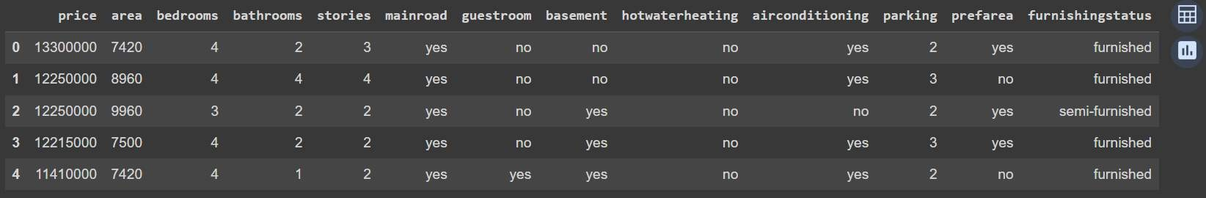
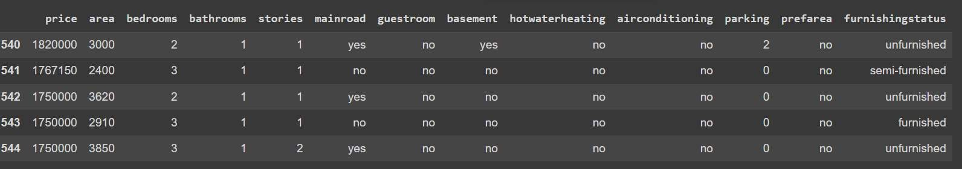
DATA SUMMARY
This is the House Prices dataset. In the below table it shows the top and bottom 5 rows respectively

Slide 8
FEATURES DESCRIPTION
price: The asking price of the property in Korean Won. area: The total floor area of the property in square meters. bedrooms: The number of bedrooms in the property. bathroom: The number of bathrooms in the property. stories: The number of stories in the property.
mainroad: Whether the property is located on a main road (yes or no). guestroom: Whether the property has a guest room (yes or no). basement: Whether the property has a basement (yes or no). hotwaterh: Whether the property has hot water heating (yes or no). airconditic: Whether the property has air conditioning (yes or no). parking: The number of parking spaces available for the property.
prefarea: Whether the property is located in a preferred area (yes or no). furnishingstatus: The furnishing status of the property (furnished, unfurnished).
semi-furnished, or

Slide 9
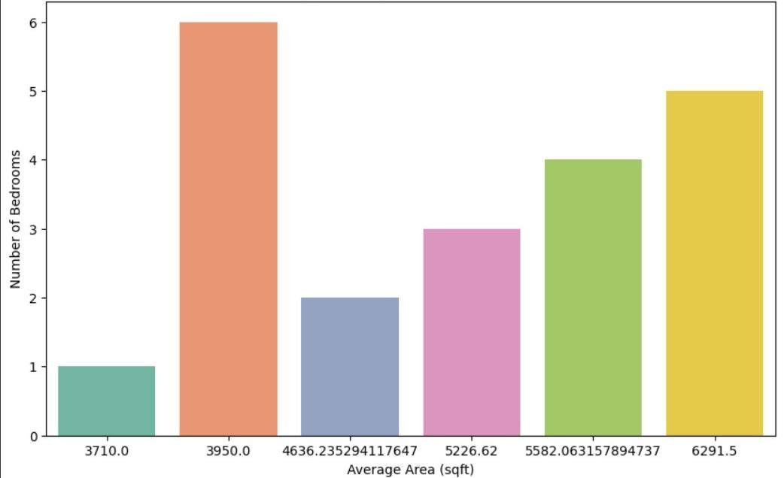
Average Area by Number Of Bedrooms
Here. I picked the horizontal bar plot because it's a suitable choice for comparing the average area across different categories (in this case, the number of bedrooms). Horizontal bar plots are effective for visualizing comparisons between categories, especially when there are several categories to display.

Slide 10
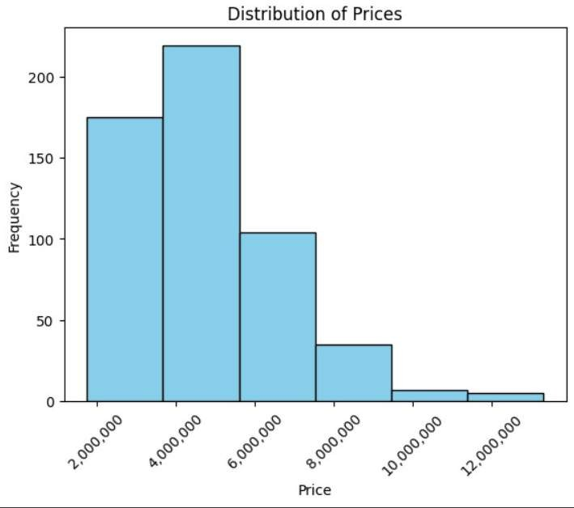
Distribution Of Prices
A histogram is chosen because it effectively visualizes the distribution of a continuous variable, in this case, the prices in the dataset. Histograms display the frequency distribution of data within specified intervals (or bins), making it easy to identify the range in which most prices fall and any patterns or outliers present in the data.

Slide 11
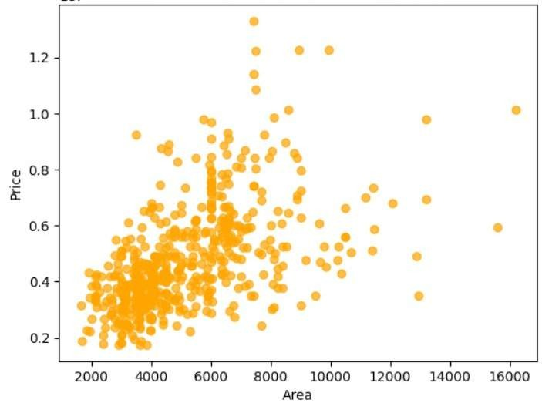
Correlation Between Area and Price
A scatter plot is chosen because it effectively visualizes the relationship between two continuous variables, in this case, 'area' and 'price'. Scatter plots help identify patterns, trends, and potential correlations between the variables. By
plotting 'area' on the x-axis and 'price' on the y-axis, we can observe how changes in the area of properties relate to changes in their prices.

Slide 12
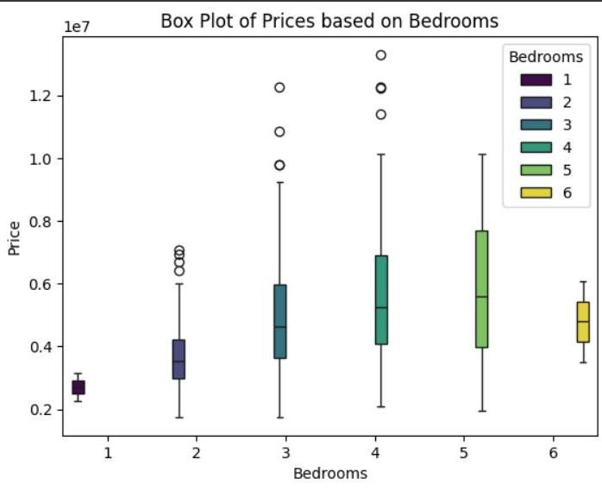
Box Plot of Prices Based on Bedrooms
A box plot is a good choice for this scenario because it effectively visualizes the distribution of prices for each bedroom category. It displays the following key information:

Slide 13
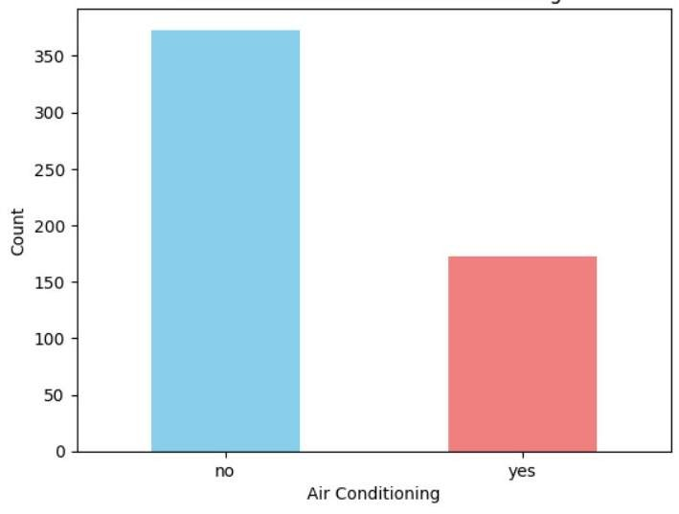
Count of Houses with Air Conditioning
A bar chart is a suitable choice for this scenario because it effectively visualizes the categorical data present in the 'airconditioning' column. This column likely contains two distinct values, such as "yes" and "no," representing whether a house has air conditioning or not.

Slide 14
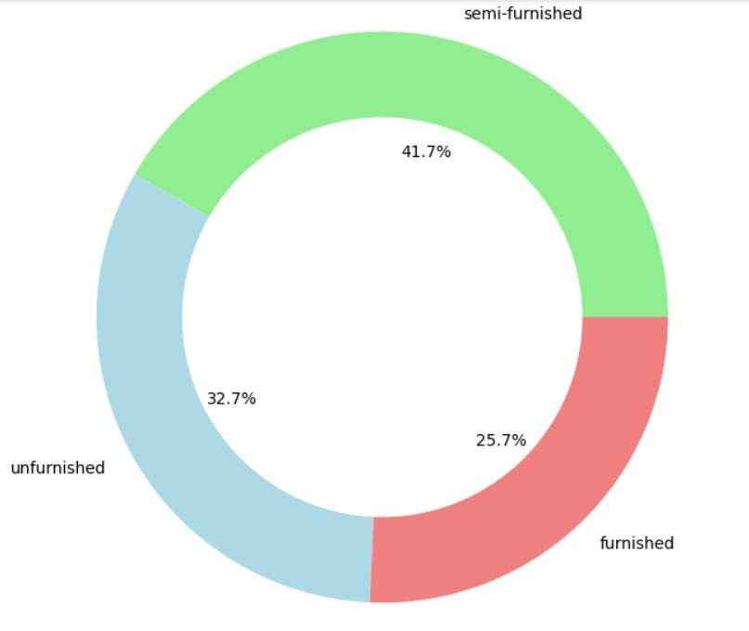
Distribution of Furnishing status
A Donut chart is a suitable choice for visualizing the distribution of furnishing status because it represents categorical data with mutually exclusive categories. This means that each house can only belong to one furnishing category (furnished, semi-furnished, or unfurnished).

Slide 15
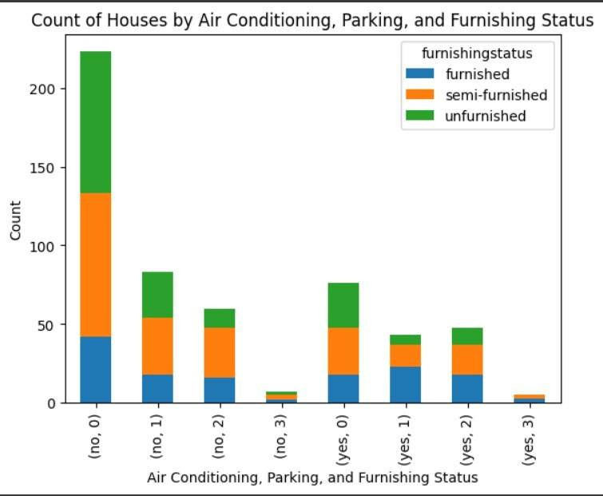
Count of Houses by Air Conditioning, Parking and Furnishing Status
This visualization uses a stacked bar chart because it effectively displays the distribution of houses across combinations of three categorical variables: air conditioning, parking availability, and furnishing status.

Slide 16
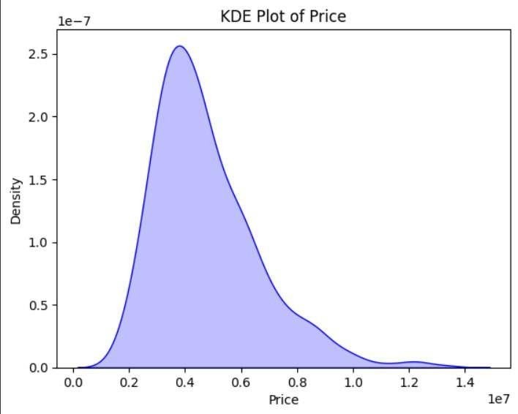
KDE Plot of Price
A KDE plot is a good choice for this scenario because it effectively visualizes the distribution of the 'price' variable, which is likely continuous and numerical.

Slide 17
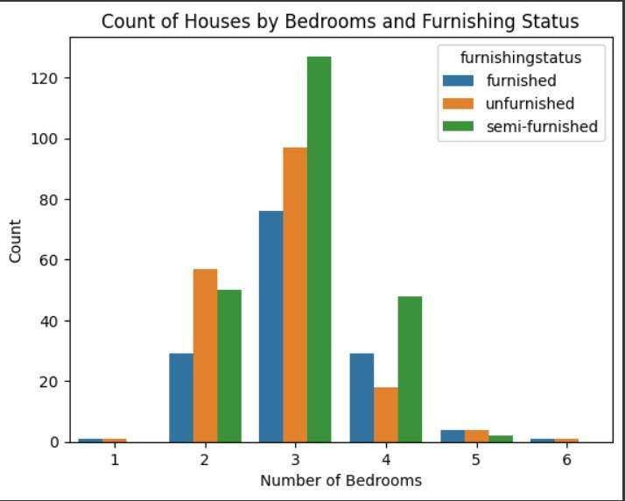
Count of Houses by Bedrooms and Furnishing Status
it effectively visualizes categorical data with two variables (bedrooms and furnishing status). It uses separate bars for each combination of categories, allowing for easy comparison of counts across different combinations.

Slide 18
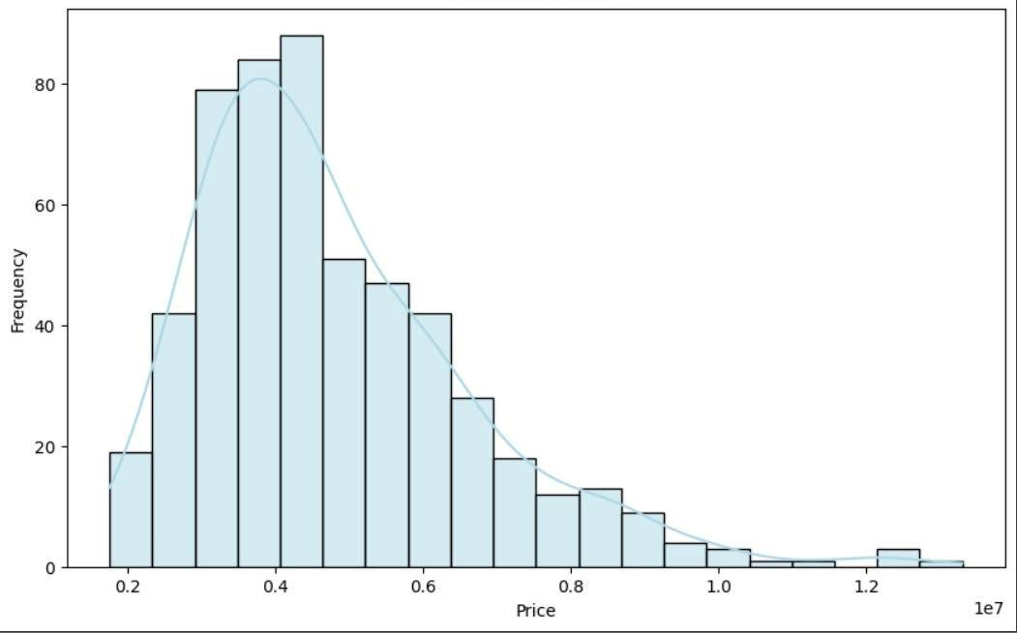
Price Distribution
A KDE+Histogram is suitable here because it effectively visualizes the distribution of categorical data (number of bedrooms) while highlighting the count for each category. It uses dodge=True to avoid overlapping bars for better readability when there are multiple categories.

Slide 19
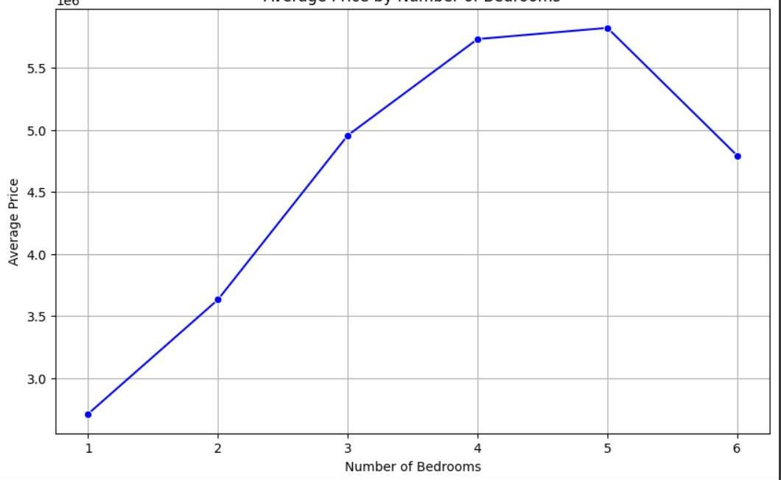
Average Price by Number of Bedrooms
A line plot is appropriate here because it effectively visualizes the trend in average price as the number of bedrooms increases. It helps identify any linear relationship or patterns between these variables.

Slide 20
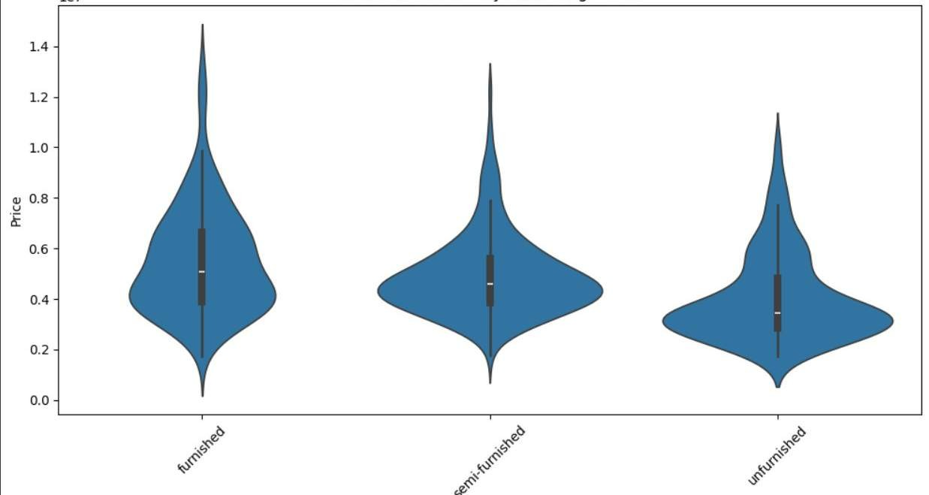
Violion Plot of Price by Furnishing Status
A violin plot is suitable here because it displays the distribution of price for each furnishing status (furnished, semi-furnished, unfurnished) while also showing the spread of data points through the violin shape.

Slide 21
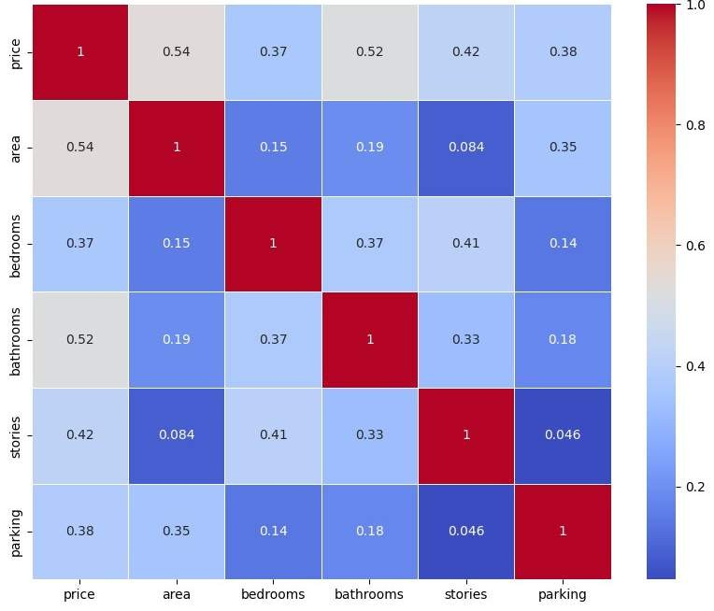
Correlation Matrix Heatmaps
Heatmaps effectively visualize correlations between multiple numerical variables simultaneously. Color-coding and annotations make it easy to identify patterns and strengths of relationships.

Slide 22
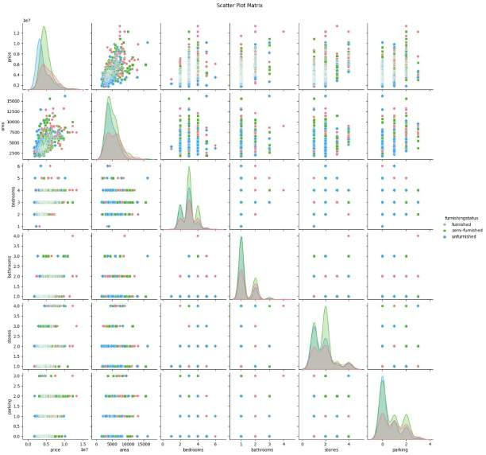
Pair Plot
Pair plots visualize relationships between multiple numerical variables in an organized grid of scatter plots. They allow for simultaneous comparison of pairs and visual assessment of correlations. It's particularly helpful for exploring potential patterns and identifying interesting relationships that might not be apparent in a correlation matrix.

Slide 23
Feature Engineering and Data Preprocessing
Feature engineering and data preprocessing are crucial steps to prepare data for training machine learning models.
1. Feature Engineering: AIML involves designing and creating relevant features from raw data that can improve the performance of machine learning algorithms. This could include transforming variables, creating new features, or selecting the most important ones.
2. Data Preprocessing: Data preprocessing in AIML involves cleaning and transforming raw data into a format suitable for machine learning algorithms. This may include handling missing values, normalizing or scaling features, encoding categorical variables, and splitting data into training and testing sets.

Slide 24
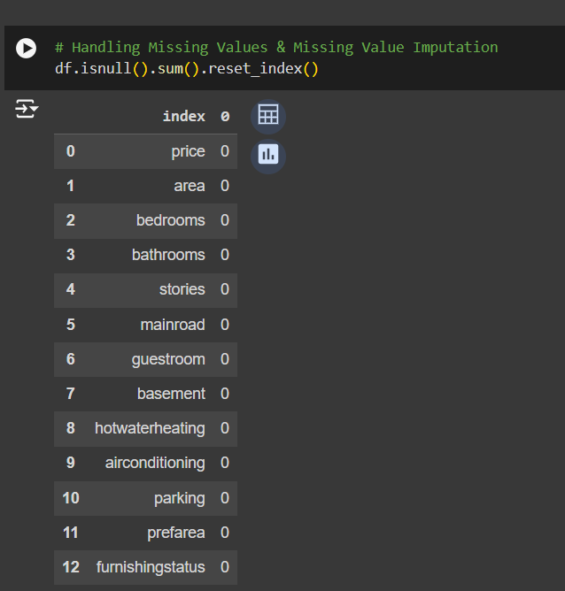
1. Handling missing values
Handling missing values in AIML involves strategies to deal with data points that are incomplete or unavailable. There is no missing values in our dataset.

Slide 25
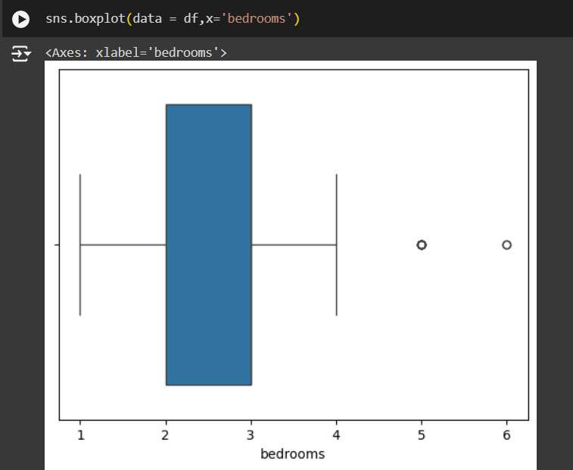
2. Handling outliers
In AIML, managing outliers is crucial for improving the robustness and accuracy of machine learning models we have use box plot to visualise it and inter quartile range to remove it.

Slide 26
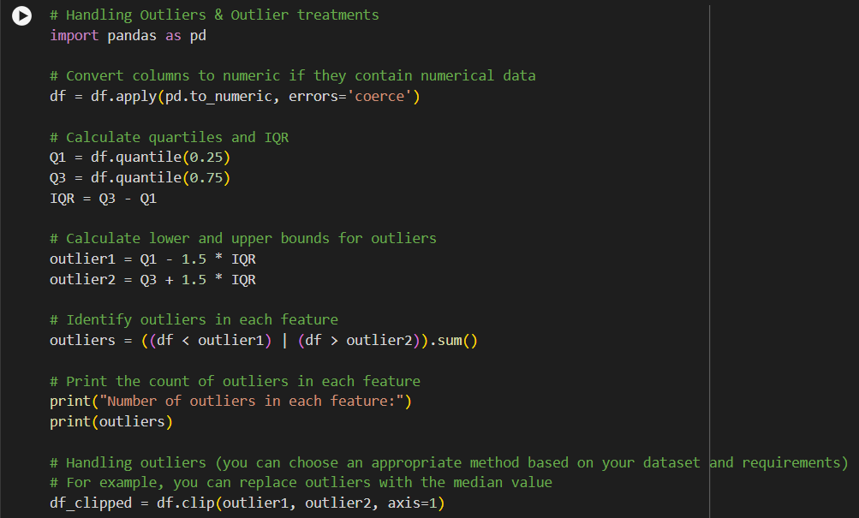
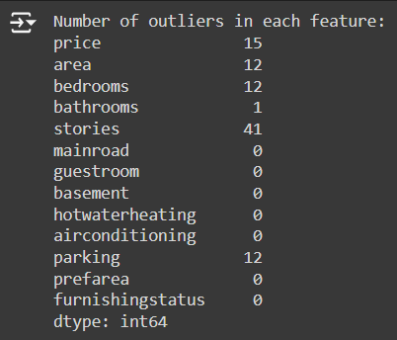
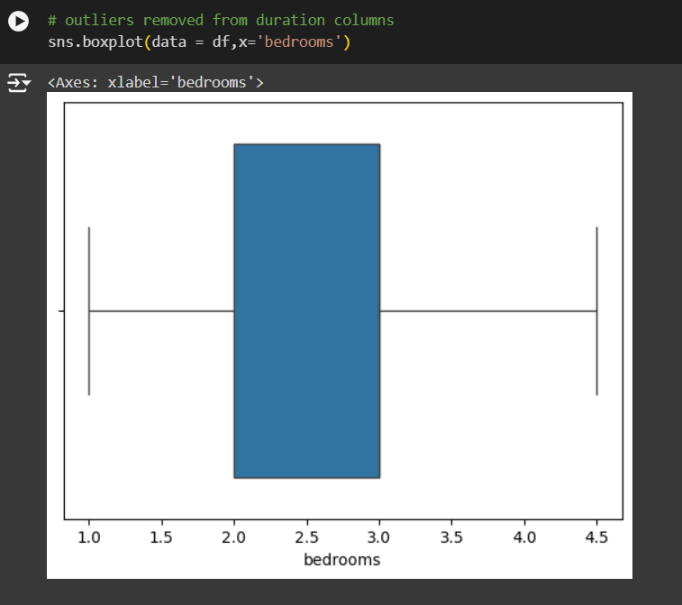
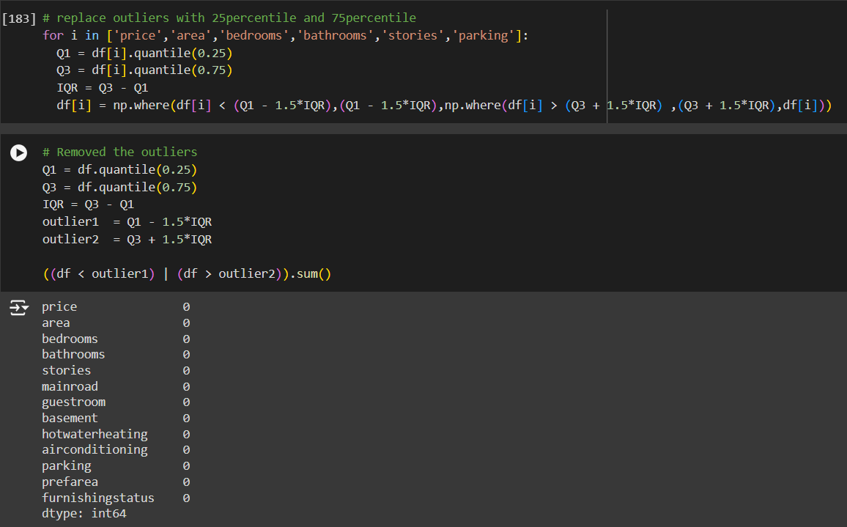
Cont.

Slide 27
3. Categorical Encoding
Categorical encoding is a crucial step in preparing categorical data for machine learning algorithms in AIML ,here we convert categorical coloumn to numerical coloumn. Here are some common techniques:
One-Hot Encoding: Convert each categorical variable into a binary vector where each category is represented by a binary feature. This creates a sparse matrix where each category is represented by a column, and only one column in each row is active (1) indicating the presence of that category.
Label Encoding: Encode categorical variables as integer labels. Each unique category is assigned a unique integer value. This approach is suitable for ordinal categorical variables where the order matters.
Ordinal Encoding: Similar to label encoding, but with a predefined order of categories. This is useful when the categorical variable has an inherent order or hierarchy.

Slide 28
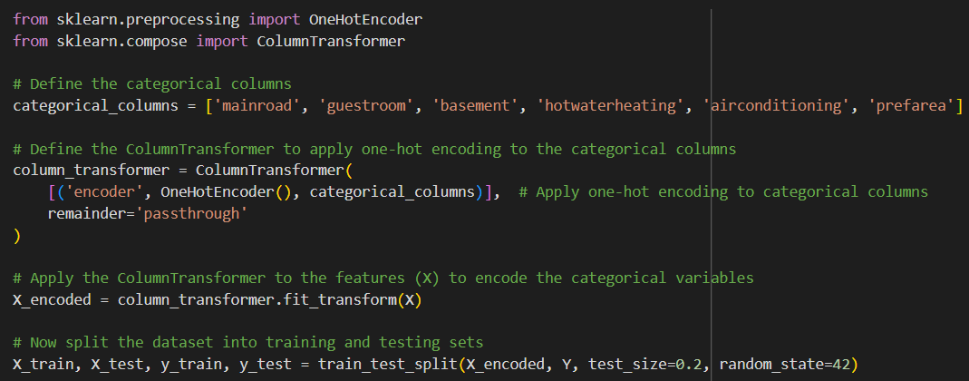
Cont.

Slide 29
4. Feature Manupulation and Selection
In AIML, feature manipulation and selection are essential for optimizing model performance and reducing dimensionality .
Feature manupulation and new features
Feature selection
Data Transformation
Scaling
Data Splitting

Slide 30
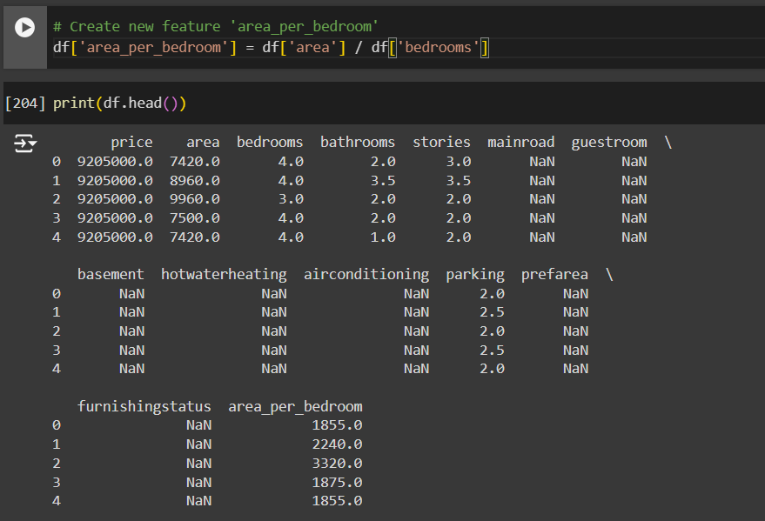
a) Feature manipulation and new features
Generate new features from existing ones to capture additional information or relationships in the data. This could involve mathematical operations, interactions between variables, or domain-specific transformations.

Slide 31
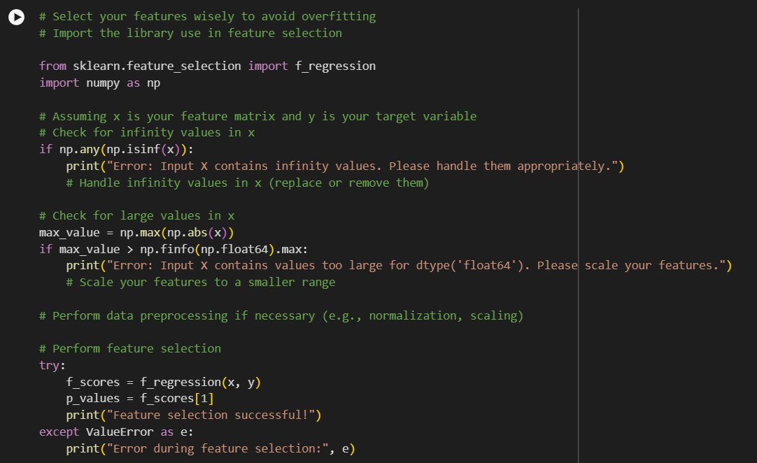
b) Feature Selection
Select relevant features to improve model efficiency and interpretability while reducing over fitting. Univariate Feature Selection with F-scores is used because This approach is suitable for scenarios where you want to quickly assess the importance of individual features and select the most informative ones for prediction.

Slide 32
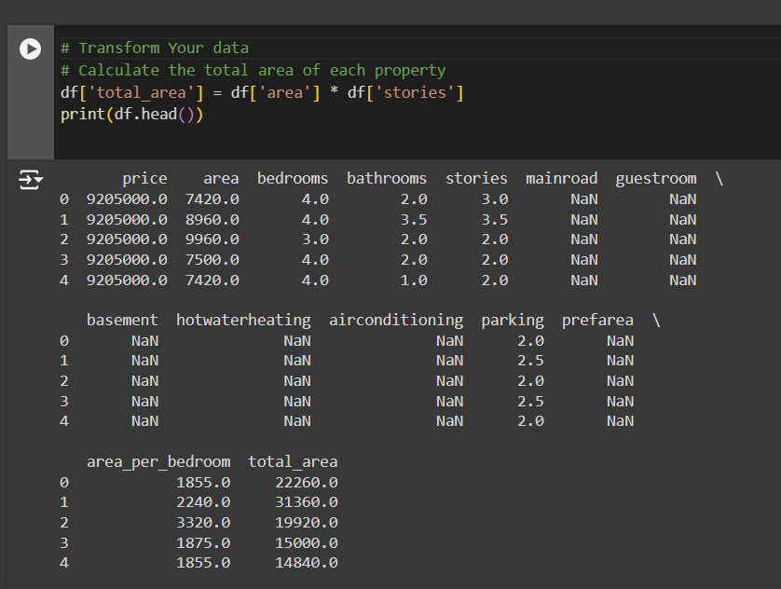
c) Data Transformation
Transform features to make them more suitable for modeling.

Slide 33
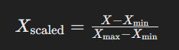
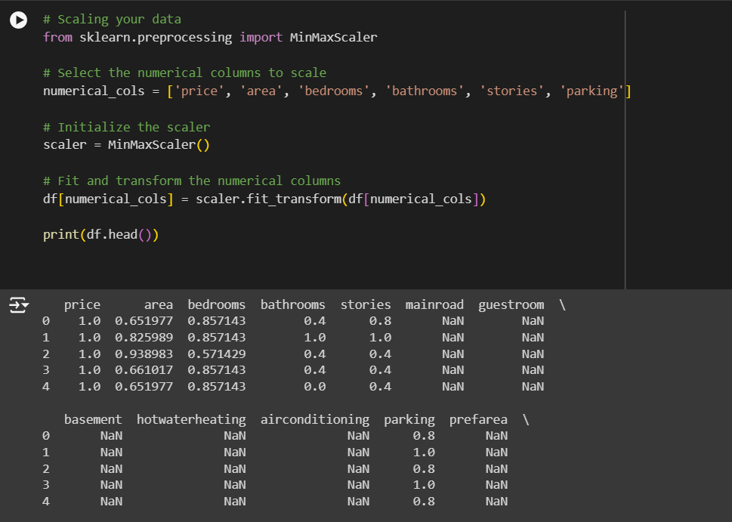
d) Scaling
Scaling is a crucial preprocessing step in machine learning, particularly when features have different scales or units. It ensures that the features are on a similar scale, preventing features with larger magnitudes from dominating the model . we have used min max-scalar.

Slide 34
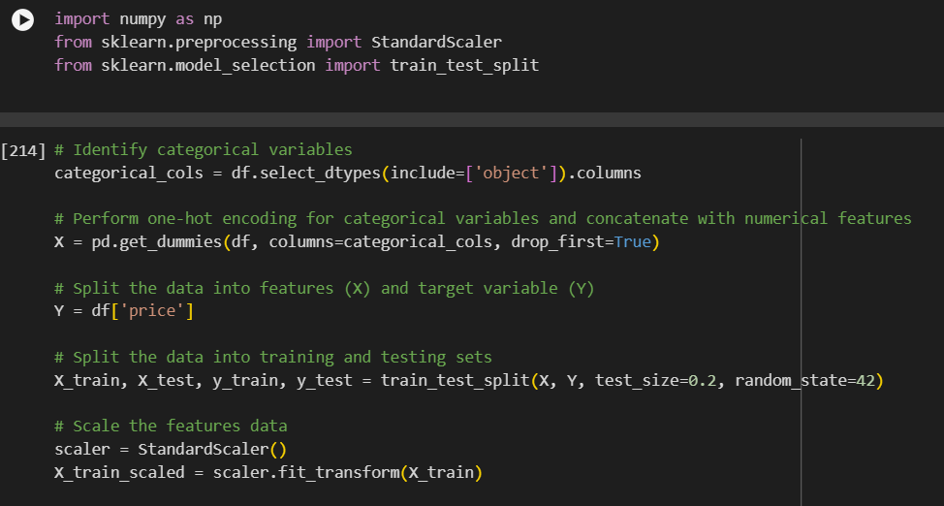
e) Data Splitting
Data splitting is a fundamental step in machine learning where the available data is divided into separate sets for training, validation, and testing. Here's a common approach for splitting the data:
Training Set: This set comprises the majority of the data and is used to train the machine learning model. The model learns patterns and relationships from this data.
2.Test Set: This set is used to evaluate the final performance of the trained model. It provides an unbiased estimate of the model's performance on unseen data.

Slide 35
ML models
There are numerous machine learning models available, each with its strengths, weaknesses, and suitability for different types of tasks and datasets. Sure, here are the names of various machine learning models:
1. Linear Regression
2. Logistic Regression
3. Decision Trees
4. SVM
5. K-means, etc.
We have used Linear Regression,Decision tree and SVM.

Slide 36
1. Linear Regression
Linear regression is a type of supervised machine learning algorithm that computes the linear relationship between the dependent variable and one or more independent features by fitting a linear equation to observed data.
Simple Linear Regression
This is the simplest form of linear regression, and it involves only one independent variable and one dependent variable. The equation for simple linear regression is:
y=β0​+β1​X where:
Y is the dependent variable
X is the independent variable
β0 is the intercept
β1 is the slope
Multiple Linear Regression
This involves more than one independent variable and one dependent variable. The equation for multiple linear regression is:
y=β0​+β1​X+β2​X+………βn​X where:
Y is the dependent variable
X1, X2, …, Xp are the independent variables
β0 is the intercept
β1, β2, …, βn are the slopes

Slide 37
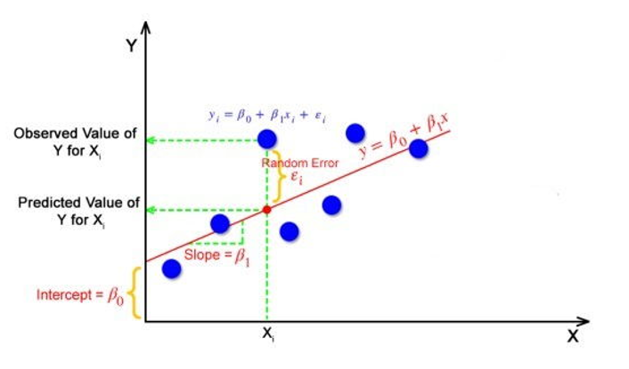
…
objective: while using linear regression is to locate the best-fit line, which implies that the error between the predicted and actual values should be kept to a minimum. There will be the least error in the best-fit line.

Slide 38
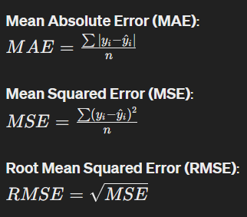
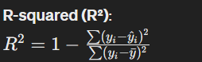
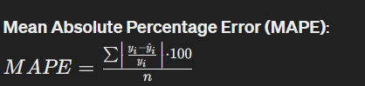
Performace metrices of Linear regression

Slide 39
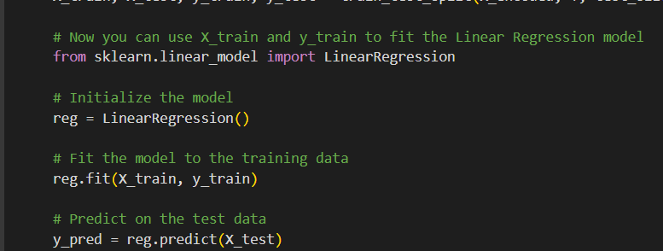
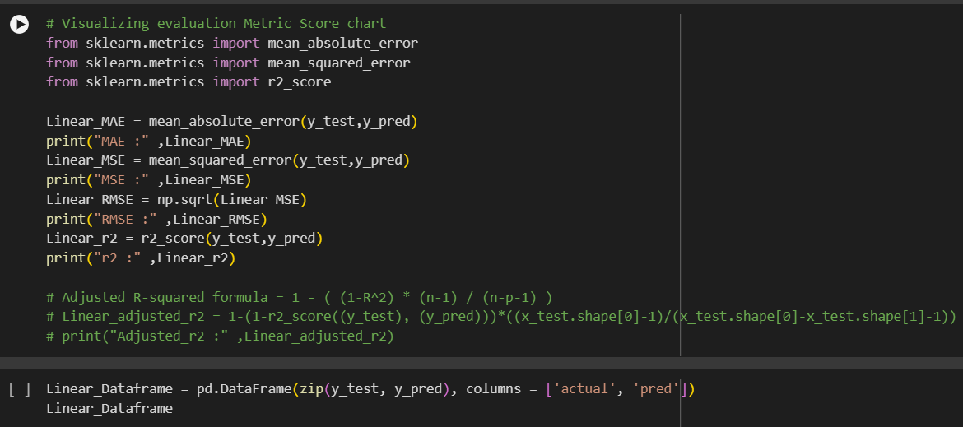
Code snippets

Slide 40
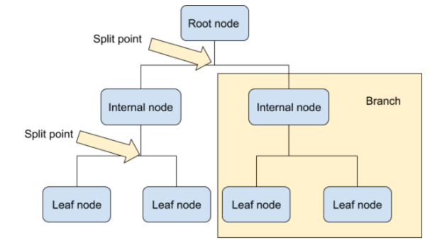
2. Decision Tree
A decision tree is one of the most powerful tools of supervised learning algorithms used for both classification and regression tasks. It builds a flowchart-like tree structure where each internal node denotes a test on an attribute, each branch represents an outcome of the test, and each leaf node (terminal node) holds a class label.
Decision trees are so versatile in simulating decision-making processes, because of their interpretability and versatility.

Slide 41
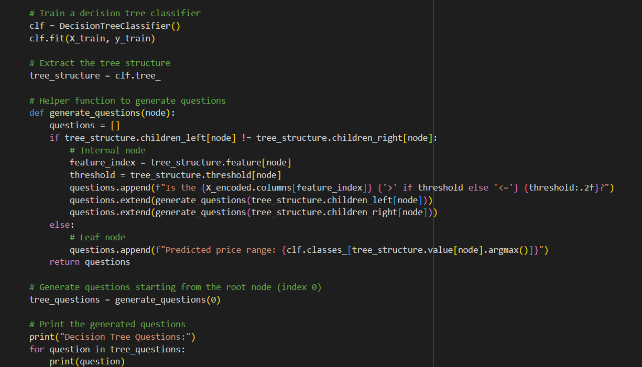
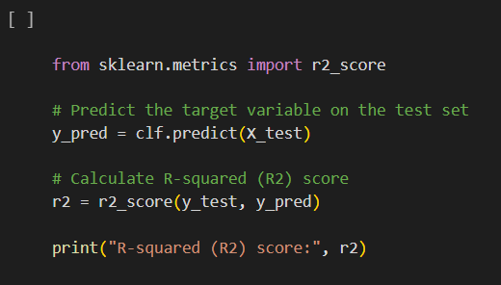
Code snippet

Slide 42
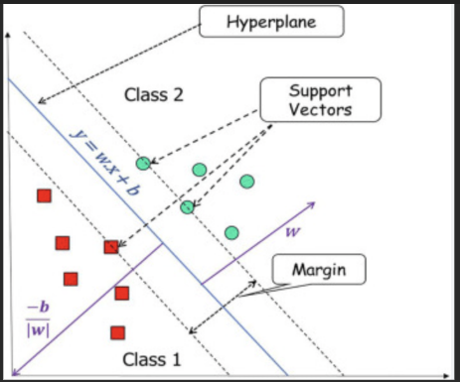
3. Support Vector Machine
Support Vector Machine (SVM) is a powerful machine learning algorithm used for linear or nonlinear classification, regression, and even outlier detection tasks.
SVM algorithms are very effective as we try to find the maximum separating hyper plane between the different classes available in the target feature.

Slide 43
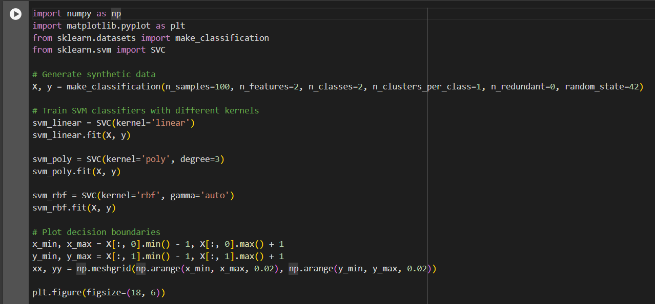
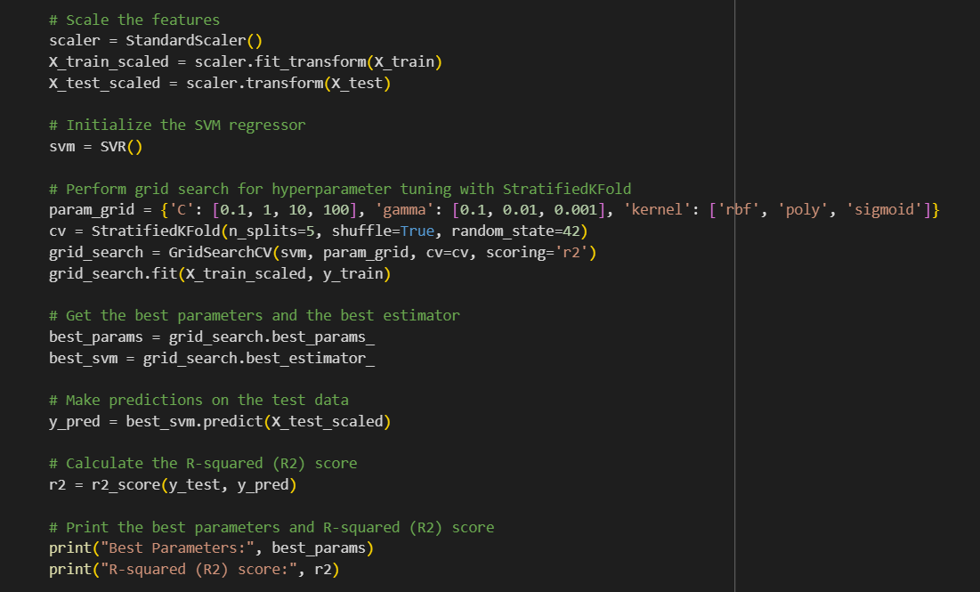
Code snippet

Slide 44

Challenges
Data Cleaning and Preprocessing: The dataset you provided might require cleaning and preprocessing before analysis. Dealing with missing values, outliers, inconsistent data formats, and duplicates could be challenging.
Data Visualization: Visualizing the data to gain insights and understanding patterns can be challenging, especially if you're dealing with a large dataset. Choosing the right visualization techniques and libraries to effectively communicate your findings can be tricky.
Statistical Analysis: Conducting statistical analysis to explore relationships between different variables and understanding the distribution of data can be complex, especially if you're not familiar with statistical concepts and techniques.
Descriptive Analysis: Performing descriptive analysis to summarize the main characteristics of the dataset, such as mean, median, mode, standard deviation, etc., might pose challenges, especially when dealing with multiple variables.
Exploratory Data Analysis (EDA): Conducting EDA to uncover patterns, trends, correlations, and anomalies in the data without using machine learning models can be time-consuming and requires a good understanding of data analysis techniques.

Slide 45

Conclusion
To wrap it up, we've explored a bunch of housing data to understand what makes a property valuable. We found out things like how size, number of rooms, and amenities like air conditioning affect the price. We also noticed trends in what people prefer when buying a house, like if they want it furnished or not, and if they care about the area it's in.
From all this, we've come up with some suggestions for people involved in real estate. Like how they can set prices better, understand what buyers want, and maybe even tweak properties to match what people are looking for.
Even though we didn't build a fancy prediction model, we still learned a lot about what drives the housing market. This info can help folks in real estate make smarter decisions when buying or selling properties.

Slide 46

Thank You!

